Slide 1
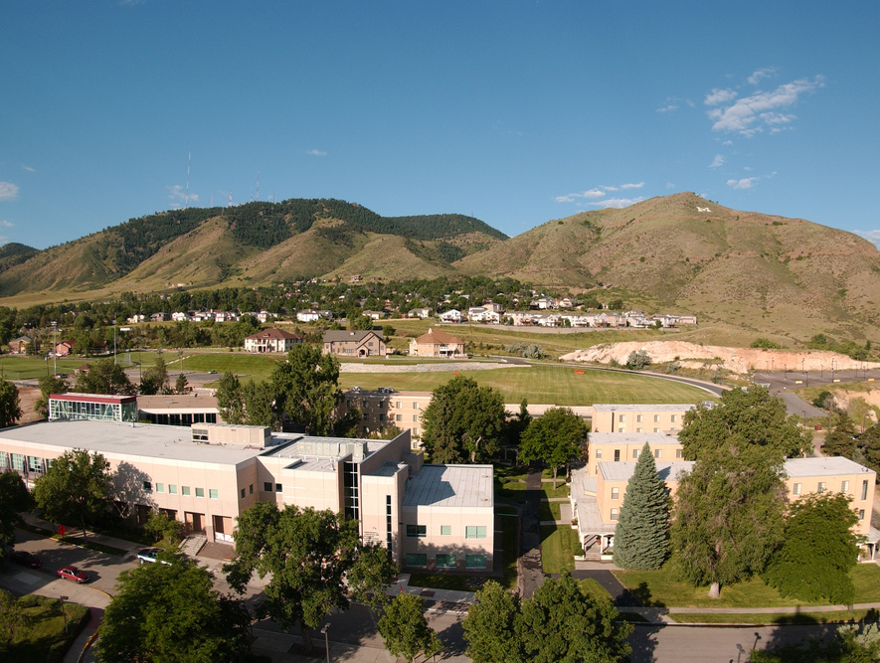
Colorado School of Mines
Computer Vision
Professor William Hoff
Dept of Computer Science
http://inside.mines.edu/~whoff/

Slide 2
Alignment Using Linear Least Squares
With Applications to 2D Image Transforms

Slide 3
Review: Least Squares Fitting to a Line
We have some measurement data (xi,yi)
We want to fit the data to y = f(x) = mx + b
We will find the parameters (m,b) that minimize the objective function
y
Example
(x1,y1) = (1,1)
(x2,y2) = (2,3)
(x3,y3) = (3,4)
x

Slide 4
Linear Least Squares
In general
The input data can be vectors
The function can be a linear combination of the input data
We write A x = b
The parameters to be fit are in the vector x
The input data is in A,b
Example of a line
Parameter vector
Linear equations
So for a line

Slide 5
Solving Linear Least Squares
Want to minimize
Expanding we get
To find the minimum, take derivative wrt x and set to zero, getting
To solve, can do
Called the “normal equations”
This quantity is called the “pseudo inverse”:

Slide 6
Example
The linear system for the line example earlier is Ax=b, where
Normal equations
So the best fit line is y = 1.5x – 0.333
y
Example
(x1,y1) = (1,1)
(x2,y2) = (2,3)
(x3,y3) = (3,4)
x

Slide 7


Finding an image transform
If you know a set of point correspondences, you can estimate the parameters of the transform
Example – find the rotation and translation of the book in the images below
We can use the four corners of the book, for point correspondences
“A”
“B”

Slide 8
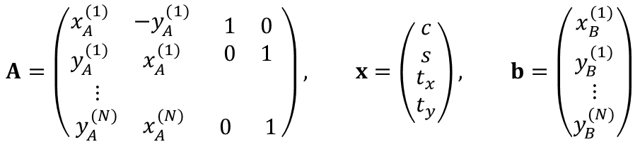
Example (continued)
A 2D rigid transform is
Or
We put into the form Ax = b, where
Note: c and s are not really independent variables; however we treat them as independent so that we get a system of linear equations
$$A=\left(\begin{matrix}\begin{matrix}x_{A}^{(1)} & −y_{A}^{(1)} \\ y_{A}^{(1)} & x_{A}^{(1)}\end{matrix} & \begin{matrix}1 & 0 \\ 0 & 1\end{matrix} \\ \begin{matrix}⋮ & \\ y_{A}^{(N)} & x_{A}^{(N)}\end{matrix} & \begin{matrix} & \\ 0 & 1\end{matrix}\end{matrix}\right), x=\left(\begin{matrix}\begin{matrix}c \\ s\end{matrix} \\ \begin{matrix}t_{x} \\ t_{y}\end{matrix}\end{matrix}\right), b=\left(\begin{matrix}\begin{matrix}x_{B}^{(1)} \\ y_{B}^{(1)}\end{matrix} \\ \begin{matrix}⋮ \\ y_{B}^{(N)}\end{matrix}\end{matrix}\right)$$

Slide 9
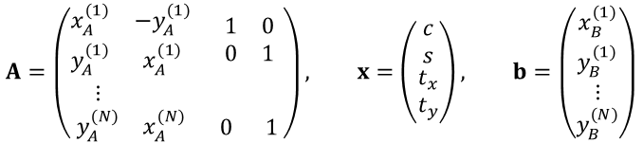
Code
$$A=\left(\begin{matrix}\begin{matrix}x_{A}^{(1)} & −y_{A}^{(1)} \\ y_{A}^{(1)} & x_{A}^{(1)}\end{matrix} & \begin{matrix}1 & 0 \\ 0 & 1\end{matrix} \\ \begin{matrix}⋮ & \\ y_{A}^{(N)} & x_{A}^{(N)}\end{matrix} & \begin{matrix} & \\ 0 & 1\end{matrix}\end{matrix}\right), x=\left(\begin{matrix}\begin{matrix}c \\ s\end{matrix} \\ \begin{matrix}t_{x} \\ t_{y}\end{matrix}\end{matrix}\right), b=\left(\begin{matrix}\begin{matrix}x_{B}^{(1)} \\ y_{B}^{(1)}\end{matrix} \\ \begin{matrix}⋮ \\ y_{B}^{(N)}\end{matrix}\end{matrix}\right)$$
import math import numpy as np def main(): # Define corresponding points. ptsA = np.array([(221, 31), (413, 20), (416, 304), (228, 308)]) ptsB = np.array([(214, 7), (404, 34), (352, 314), (169, 280)]) num_pts = len(ptsA) # len() returns size of the first dimension # Form the "A" matrix, row by row. A = np.zeros((2*num_pts, 4)) for i in range(num_pts): A[2*i, :] = [ ptsA[i,0], -ptsA[i,1], 1, 0] A[2*i+1, :] = [ ptsA[i,1], ptsA[i,0], 0, 1] print(A) # Reshape points into a column vector: [ x0,y0,x1,y1,x2,y2,x3,y3 ]. b = np.reshape(ptsB, 2*num_pts) print(b) Ap = np.linalg.pinv(A) # Pseudo inverse x = Ap @ b # Solve for the least squares solution # Extract the parameters from the solution vector. theta = math.acos(x[0]) tx = x[2] ty = x[3] print("Theta: %f degrees" % math.degrees(theta)) print("tx,ty: %f,%f" % (tx,ty)) if __name__ == "__main__": main()
Output
[[ 221. -31. 1. 0.]
[ 31. 221. 0. 1.]
[ 413. -20. 1. 0.]
[ 20. 413. 0. 1.]
[ 416. -304. 1. 0.]
[ 304. 416. 0. 1.]
[ 228. -308. 1. 0.]
[ 308. 228. 0. 1.]]
[214 7 404 34 352 314 169 280]
Theta: 11.575544 degrees
Translation tx,ty: 3.758761,-65.332203
Note: you might get slightly different values of theta, from c and s. You could average them to get a better estimate.

Slide 10
Example - affine
An “affine” transform is more general than a 2D rigid transform
It is a good approximation for small out-of-plane rotations
book1.jpg
book2.jpg

Slide 11
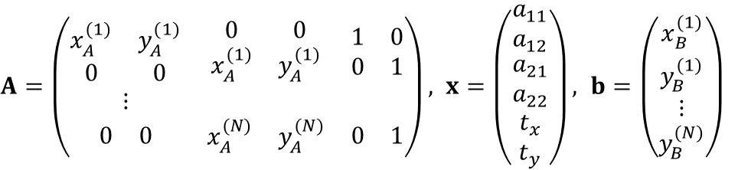
Example – affine (continued)
We write the system of linear equations Ax=b for least squares fitting of an affine transformation
An affine transformation has the form
There are 6 unknowns so we need at least 3 corresponding points.
The system of linear equations is Ax=b where
or
$A=\left(\begin{matrix}\begin{matrix}x_{A}^{(1)} & y_{A}^{(1)} \\ 0 & 0\end{matrix} & \begin{matrix}0 & 0 \\ x_{A}^{(1)} & y_{A}^{(1)}\end{matrix} & \begin{matrix}1 & 0 \\ 0 & 1\end{matrix} \\ ⋮ & & \\ \begin{matrix}0 & 0\end{matrix} & \begin{matrix}x_{A}^{(N)} & y_{A}^{(N)}\end{matrix} & \begin{matrix}0 & 1\end{matrix}\end{matrix}\right), x=\left(\begin{matrix}\begin{matrix}a_{11} \\ a_{12}\end{matrix} \\ \begin{matrix}a_{21} \\ a_{22}\end{matrix} \\ \begin{matrix}t_{x} \\ t_{y}\end{matrix}\end{matrix}\right), b=\left(\begin{matrix}\begin{matrix}x_{B}^{(1)} \\ y_{B}^{(1)}\end{matrix} \\ \begin{matrix}⋮ \\ y_{B}^{(N)}\end{matrix}\end{matrix}\right)$

Slide 12
Example – affine (continued)
As before, we find corresponding points between the two images
Again, we will use the four corners of the book

Slide 13
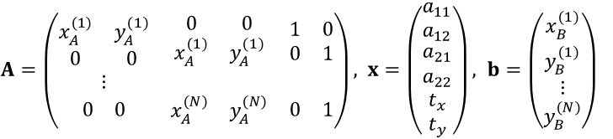
Code
$A=\left(\begin{matrix}\begin{matrix}x_{A}^{(1)} & y_{A}^{(1)} \\ 0 & 0\end{matrix} & \begin{matrix}0 & 0 \\ x_{A}^{(1)} & y_{A}^{(1)}\end{matrix} & \begin{matrix}1 & 0 \\ 0 & 1\end{matrix} \\ ⋮ & & \\ \begin{matrix}0 & 0\end{matrix} & \begin{matrix}x_{A}^{(N)} & y_{A}^{(N)}\end{matrix} & \begin{matrix}0 & 1\end{matrix}\end{matrix}\right), x=\left(\begin{matrix}\begin{matrix}a_{11} \\ a_{12}\end{matrix} \\ \begin{matrix}a_{21} \\ a_{22}\end{matrix} \\ \begin{matrix}t_{x} \\ t_{y}\end{matrix}\end{matrix}\right), b=\left(\begin{matrix}\begin{matrix}x_{B}^{(1)} \\ y_{B}^{(1)}\end{matrix} \\ \begin{matrix}⋮ \\ y_{B}^{(N)}\end{matrix}\end{matrix}\right)$
import numpy as np def main(): # Define corresponding points. ptsA = np.array([(120, 28), (422, 6), (106, 472), (557, 400)]) ptsB = np.array([(201, 6), (501, 28), (81, 420), (536, 462)]) num_pts = len(ptsA) # len() returns size of the first dimension # Form the "A" matrix, row by row. A = np.zeros((2*num_pts, 6)) for i in range(num_pts): A[2*i, :] = [ ptsA[i,0], ptsA[i,1], 0, 0, 1, 0] A[2*i+1, :] = [ 0, 0, ptsA[i,0], ptsA[i,1], 0, 1] print(A) # Reshape points into a column vector: [ x0,y0,x1,y1,x2,y2,x3,y3 ]. b = np.reshape(ptsB, 2*num_pts) print(b) Ap = np.linalg.pinv(A) # Pseudo inverse x = Ap @ b # Solve for the least squares solution # Get parameters from the solution vector; put into a transformation matrix. T = np.array([ (x[0], x[1], x[4]), (x[2], x[3], x[5]), (0, 0, 1), ]) print("Affine transformation matrix:", T) if __name__ == "__main__": main()
Output
[[120. 28. 0. 0. 1. 0.]
[ 0. 0. 120. 28. 0. 1.]
[422. 6. 0. 0. 1. 0.]
[ 0. 0. 422. 6. 0. 1.]
[106. 472. 0. 0. 1. 0.]
[ 0. 0. 106. 472. 0. 1.]
[557. 400. 0. 0. 1. 0.]
[ 0. 0. 557. 400. 0. 1.]]
[201 6 501 28 81 420 536 462]
Affine transformation matrix:
[[ 0.97196831 -0.24169206 91.68779639]
[ 0.21710822 0.97897709 -58.14216236]
[ 0. 0. 1. ]]

Slide 14
Transform the image
Using our estimated transformation matrix T, let’s transform image A to align it with image B
We can do this because we know that T maps points from A to B; i.e., pB = T * pA

Slide 15
Generating another image using a transform
We can transform every point in image A to the corresponding location in image B; ie, pB = T pA
But instead we use the inverse, pA = T⁻¹ pB
Then we scan through every point pB in the output image, and calculate the point pA in the input image where we should get the intensity value to use
This makes sure that we don’t miss assigning any pixels in the output image
If pA falls at a non-integer location, we just take the value at the nearest integer point (a better way to do it is to interpolate among the neighbors)
input
output
pA
pB = T pA
pB
input
output
pA
pA = T⁻¹ pB
pB

Slide 16
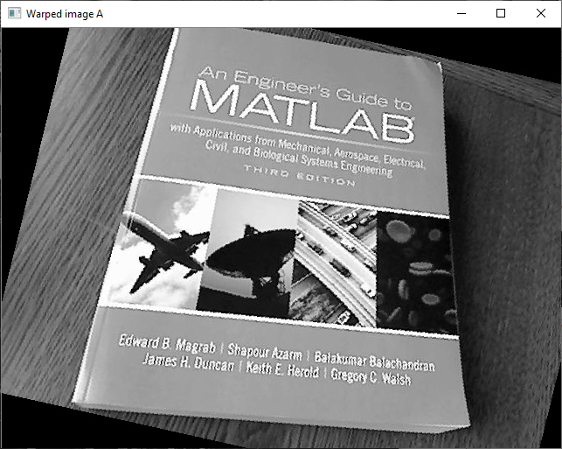
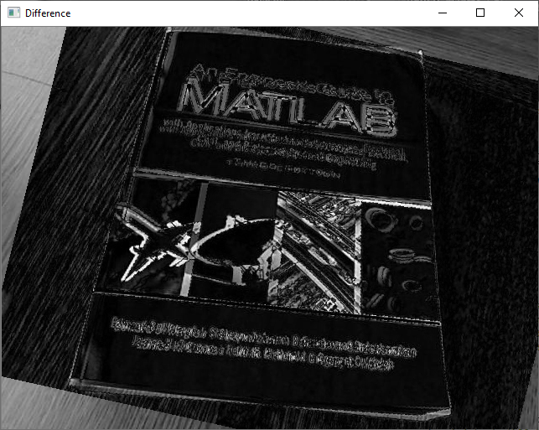
# Read images. img_A = cv2.imread("bookA.jpg", cv2.COLOR_BGR2GRAY) img_B = cv2.imread("bookB.jpg", cv2.COLOR_BGR2GRAY) # Warp image A to image B. Tinv = np.linalg.inv(T) # Get inverse of T; such that pA = Tinv * pB img_warped_A = np.zeros(img_B.shape, dtype=np.uint8) for xB in range(img_B.shape[1]): for yB in range(img_B.shape[0]): pB = np.array([xB, yB, 1]) pA = Tinv @ pB pA = pA / pA[2] # Pick the nearest point to pA (better way is to interpolate). xA = int(round(pA[0])) yA = int(round(pA[1])) if xA>=0 and xA<img_A.shape[1] and yA>=0 and yA<img_A.shape[0]: img_warped_A[yB,xB] = img_A[yA,xA] cv2.imshow("Warped image A", img_warped_A) cv2.imshow("Difference", cv2.absdiff(img_B, img_warped_A))

Slide 17

OpenCV functions
estimateAffine2D()
Computes an optimal affine transformation between two 2D point sets
warpAffine()
The function warpAffine transforms the source image using the specified matrix:
Modifed code:
T,_ = cv2.estimateAffine2D(ptsA, ptsB) img_warped_A = cv2.warpAffine(img_A, T, img_B.shape)

